Slide 1
Electronics and Payload

Slide 2
E&P Team Overview
Objective: Develop and test all electronic systems to support the team
Testing, Launch, Flight, Recovery
Safety, Reliability, Competition Standards
Integrate a unique and competitive 10 pound payload.
Payload & Avionics Mounting – Travis Bates
Critical Flight Operations – Armando Gonzalez
Launch Controls – Tommy Arrington
Sensor Implementation – Bradford Stricklin
Overview
Electronics & Payload

Slide 3
Design Summary
Progress:
Selected new primary flight computer
Designed avionics mounting bay
Redesigned launch control system
Flight sensor development
Reestablished payload collaboration
Moving Forward:
Complete Riverside Campus engine test facility
Detailed design for all systems with thorough testing
Payload integration
Summary
Electronics & Payload

Slide 4
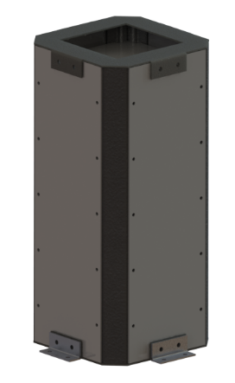
Payload
Rules:
Must be a minimum of 10 lbs.
Must be of scientific/engineering merit
Cannot interfere with rocket stabilization
CubeSat Payload:
Developed by student team at University of Sydney, led by Dr. Xiaofeng Wu
We will be collaborating with winning team to “field test” their design, see how it preforms under launch conditions
Planned on vibration test, as well as other tests they may need
Bonus creativity and points for international effort on extremely valid engineering payload
Still unspecified mass and dimensions, last year total E&P system was 12.88 lbs.
NOTE: Unlike last year, we expect the CubeSat to carry enough mass to cover the 10 lb. requirement, therefore the unassociated electronics and hardware are considered separate from payload
Payload
Electronics & Payload

Slide 5
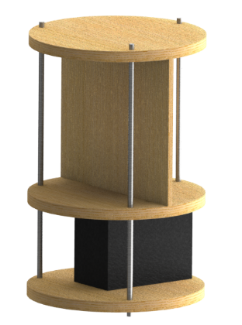
Electronics Mounting
Requirements/Rules
Our goal is to provide a separate and detachable electronics tower, capable of accepting various sensors at different locations, while adhering to competition rules
Design
Mounting tower will be machined out of hard plywood
Three horizontal platforms, creating two sections, bottom for battery, top for primary electronics, holes drilled through platforms for wires
Top section has vertical board for all electronics to be mounted for single axis mindfulness
Three all through threaded rods, secured with lock nuts at each platform
Connected to rocket body with clamp brackets attached to each platform
Next steps…
Two additional bottom section mounts for additional surface
Consider materials (rubber or 3D polymer) for scientific merit/dampening properties
Add components (flight computers, etc.) to model, as well as structural components
Add in switches to turn on flight critical components directly before launch
Mounting
Electronics & Payload

Slide 6
Critical Flight Operations
Objectives
Implement reliable redundant systems in interest of safety
Replace the previous SRT 2 G-Wiz flight computer
Provide GPS telemetry
Provide a live data feed
Approach
Research and decide on a new primary flight computer
Implement and test with body tube
Factors for New Flight Computer
Price
Accessibility/Programmable
Power Draw
Range
Flight Computers
Electronics & Payload

Slide 7
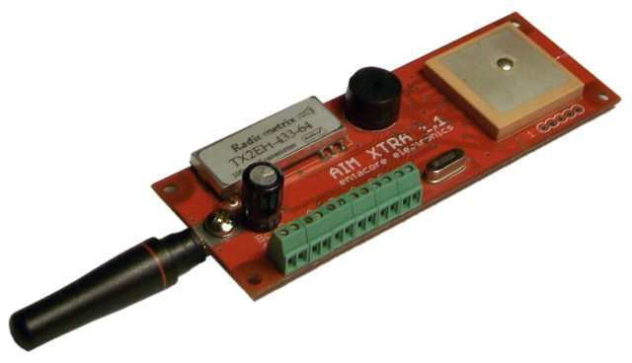
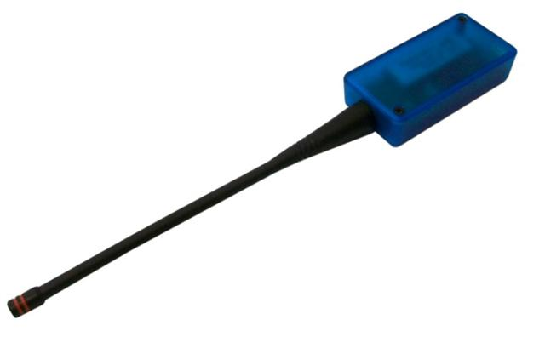
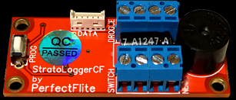
Critical Flight Operations
AIM Xtra
AIM Xtra Primary Flight Computer
512 MB of Ram
Kit included antennas operating at 50 mW 432-435 MHz band
6 pyro channels
30 km line of sight range with provided antennas
5 hours of operation with independent 3.7/7.4V 1000mAh LiPo battery
100 samples per second
Kit price of 420.00 (Reduced down to 240.00)
StratoLogger CF Redundant Flight Computer
2 pyro channels
18 minute recording time
4V-16V, 9V standalone battery
20 samples per second
Reused Component
AIM Base
Stratologger CF
Flight Computers
Electronics & Payload

Slide 8
Critical Flight Operations - Tracking
System Operation
The AIM Xtra will be transmitting data packets, received by AIM Base which will be connected to a laptop on the ground
Parachute deployment will be preset and monitored by the primary and redundant flight computers
Telemetry
The reason for the telemetry aside from providing recovery GPS coordinates is to provide flight data
Flight data can then be used for efficiencies studies as well as a base for improvement for next year’s rocket
Connectivity Tests / Preliminary GPS Tracking
Connectivity tests were conducted with lasts year’s BigRedBee GPS transmitter and demonstrated that the RF transparent gap in the carbon fiber body tube allowed reliable data packet transmission
Range tests will be performed this week
Tracking
Electronics & Payload

Slide 9
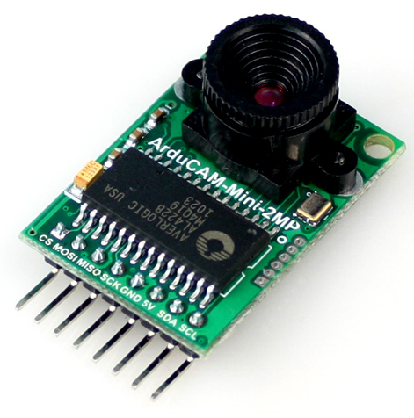
Launch Relay System - Requirements
Provide 9+ channels to fill and ignite the rocket
Arming, Nitrous fill/vent, Helium fill/vent, Oxygen fill, Nitrous/Helium quick disconnect (or 1 QD and 1 3-way valve), Igniter
Provide control from 1500 ft.
Tripoli Rocketry Association Safe Launch Practices – Part V. Distance Tables
Stream live data back to control station
Tank pressure, temperature, video feed (ArduCam), QD status
Future Use
Extra control channels, all AC or DC components, modularity
Maximize part reuse from SRT-1 and SRT-2
ArduCam OV2640
Launch System
Electronics & Payload

Slide 10
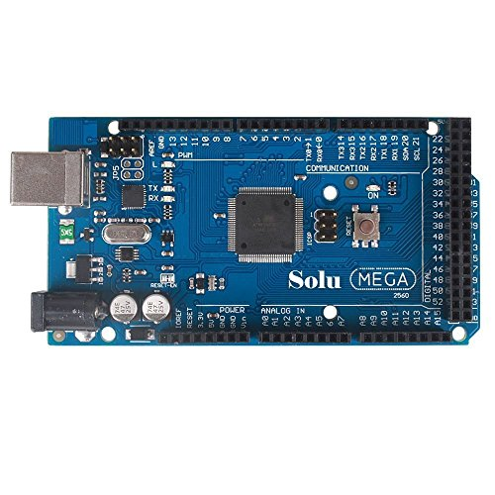
Launch Relay System – Parts and Design
Communication – Wireless
USB, Ethernet, BNC, Serial - ~300 ft. max range
2000 ft. Cat. 6 Cable + 2 Ethernet Extenders: $1,970.98
Wireless communication with 2 XBees: ~$200
System Upgrades and Reuse
All-DC conversion is much less expensive, but requires 2 car batteries
Car battery capacity >> energy required for hours of system operation
9 relay channels (54 max): 7x 12V relays (4 reused), 2x 24V relays
Ximico Mega 2560 R3
Launch System
Electronics & Payload

Slide 11
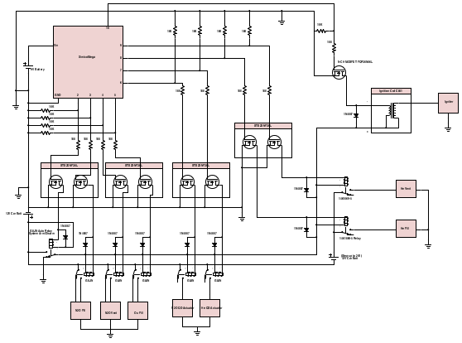
Launch Relay System - Diagram
Ximico Controller (54 channels)
Ignition System
(with MOSFET Controller)
9V Battery
(isolated Ximico supply, ~5 hrs.)
24V Relays
N-Ch MOSFETs
(with 10K Ω pull-down
Resistors)
He Solenoids
12V Car Batt.
12V Auto Relays
with flyback diodes
12V Car Batt.
(24V Step Up)
Arming Relay
Solenoids
Launch System
Electronics & Payload

Slide 12
Launch Relay System – Progress and Challenges
Proof of Concept – 12V relay control with Arduino
Circuit with transistor, 10K Ω pull-down, and 100 Ω safety resistor
Successfully actuated relay
Ignition System – Option 1
Spark igniter in combustion chamber – reliable, reusable, simple
High voltage ignition coil in launch box (1.6 lbs.)
Launch relay system tells flight computer to start oxidizer flow
Ignition System – Option 2
Legacy solid ignition charge pulsed by Monster Relay
Launch System
Electronics & Payload

Slide 13
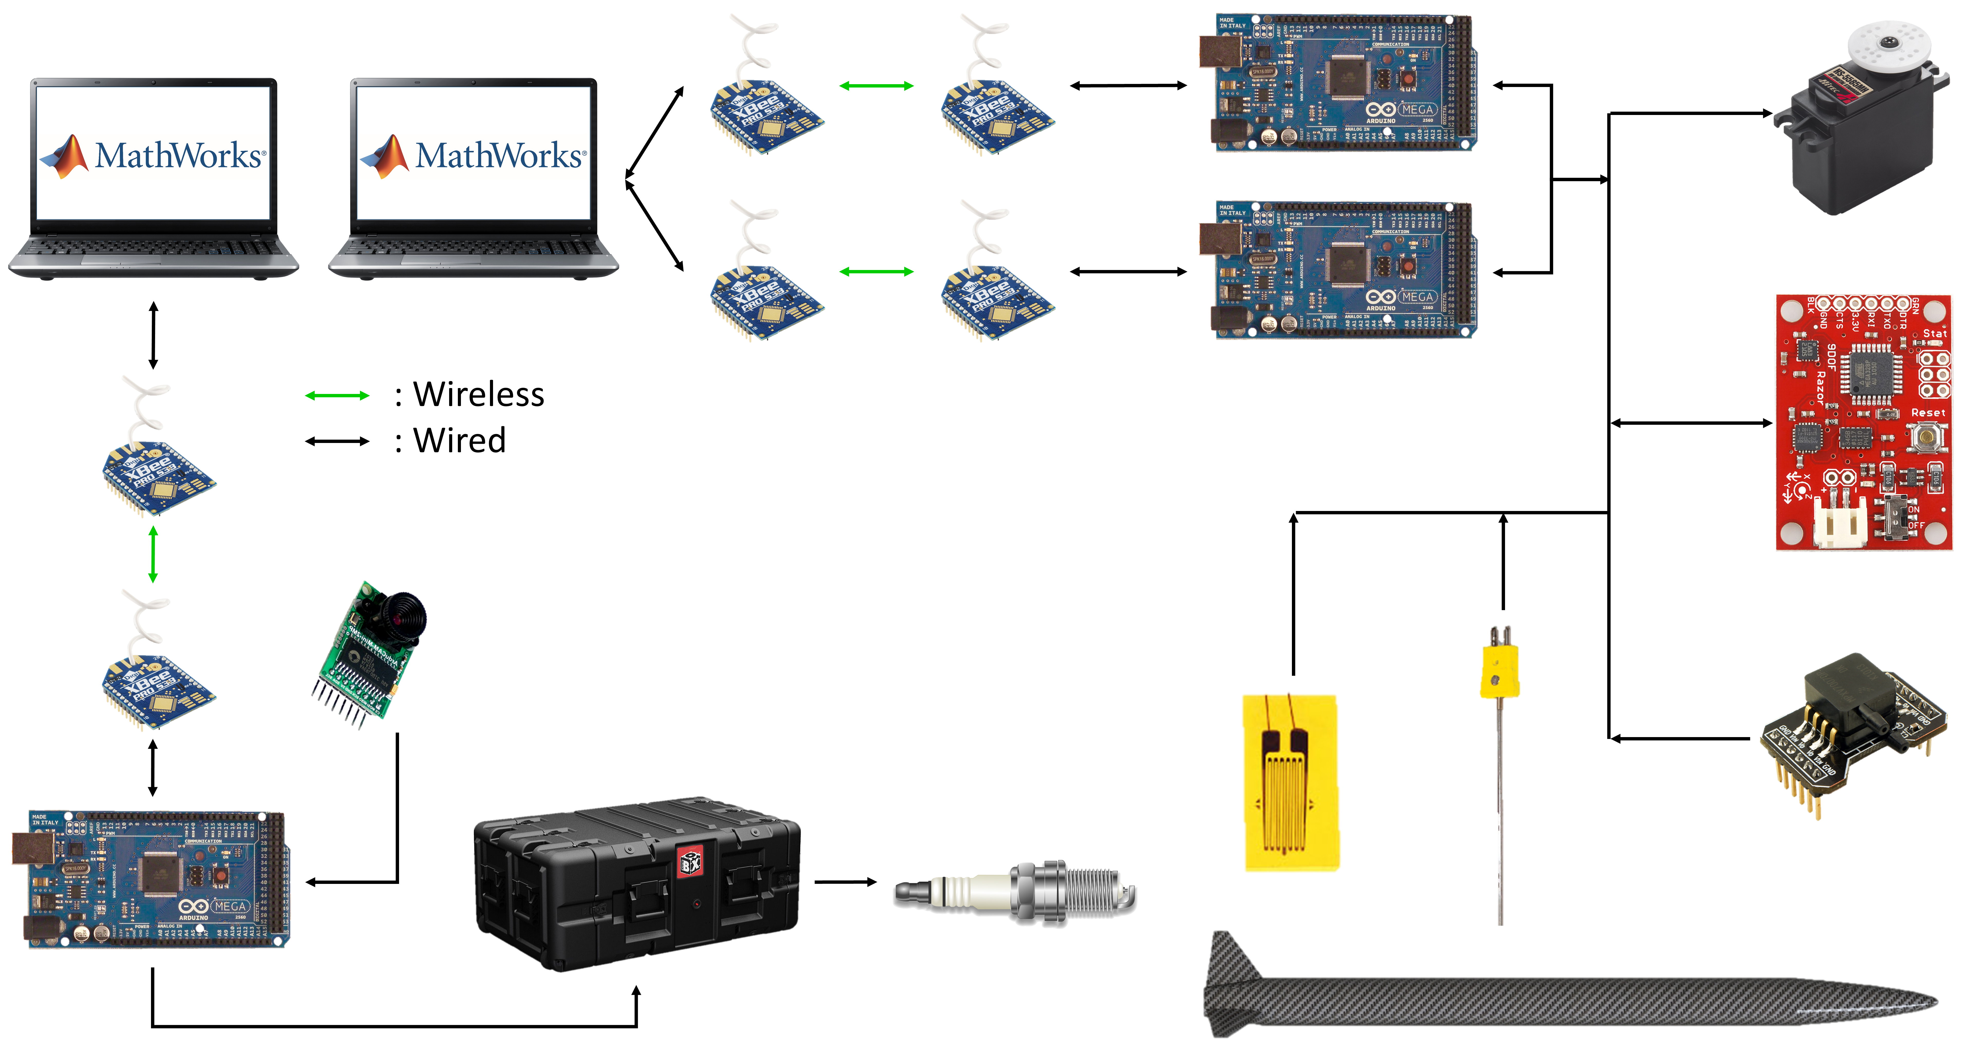
Data & Communication Systems Architecture
SD card may be mounted to Arduinos in case LOS is lost
XBees transmit 900MHz at 200 kbps at 4 miles
Wireless Comm.
Electronics & Payload

Slide 14
Command Structure
Use launch operations computer to send command to launch box or vehicle
MathWorks includes support package for Arduino communication
Arduino receives command then sends back that it received command
If Arduino does not acknowledge, we will know to send command again
Arduino sends status update when command is completed
In case of sensors, data collection begins
In case of one-time command, a short message is sent
Wireless Comm.
Electronics & Payload

Slide 15
Sensors
Necessary for testing and flight data collection
Vehicle will contain an IMU, two pressure sensors, and three thermocouples
May also support payload
Data will be read in from the Arduinos
The system is flexible enough that additional sensors can be easily added on to the system for testing or normal flight operations
Flight Sensors
Electronics & Payload

Slide 16
Power Requirements
Sensor | Voltage | Current | Power | Quantity
Thermocouple | 3.3 V | Negligible | N/A | 3
IMU | 3.3 V | 1.2 mA | 3.96 mW | 1
Strain Gauge | 5 V | 100 mA | 500 mW | 2
Pressure Transducer | 12 V | 10 mA | 120 mW | 2
Arduino | 5 V | 25 mA | 125 mW | 2
XBee | 3 V | 95 mA | 285 mW | 2
Flight Total: | - | 461.2 mA | 2.064 W | 12
Will be utilizing last year’s battery
Arduinos require 5V so must be wired to regulator
Arduinos require much less power than BeagleBones so have plenty of energy to spare with last years battery
This means any additional sensors added do not cause a concern with regard to power
Power
Electronics & Payload
Notes:
Arduinos are able to output 500 mA each

Slide 17
Testing
Successfully transmitted data between Arduinos via XBee
Two-nodal communication, not ZigBee
Successfully read in calibrated data from thermocouples
Successfully read in calibrated data from IMU
Waiting on pressure sensor selection
Will begin testing servo motor for propulsion soon
Testing
Electronics & Payload

Slide 18
Propulsion Safety Shutoff
Propulsion would like the feature of an automatic engine shutoff should sensor data fall outside of acceptable bounds
Data from failing rocket would trigger the Arduino to close the ball valve
Arduino would check IMU, temperature, and pressure data to determine if shutoff was necessary
Could potentially save rocket from critical failure while causing only a premature shutdown
Engine Safety
Electronics & Payload
Notes:
Data in sensors is inherently “jumpy” so multi-data-point average necessary for useful data
Thorough testing of IMU necessary to test for drift
Speed of ball valve closure greatly determines effectiveness of such measures

Slide 19
Total Weight of Electronics and Payload
Component | Quantity | Weight (lb)
Arduino | 2 | 0.08
Voltage Regulator | 1 | 0.03
IMU | 1 | 0.015
Xbee radio | 2 | 0.018
Thermocouple | 3 | 0.016
Thermo. Amplifier | 3 | 0.009
piezo-vibration | 4 | 0.005
strain gauge | 2 | 0.0006
hardware/shelves | 1 | 3
Battery | 1 | 3.25
Strattologger | 1 | 0.028
Aim Xtra | 1 | 0.13
CubeSat | 1 | 10
 | Total: | 16.7452
Electronics: 6.75 lbs.
Payload Estimate: 10.0 lbs.
Combined: 16.75 lbs.
Weight Estimation
Electronics & Payload

